Slide 1
ConsumIt Iteration 2
Calvin McLain
Joshua Burton
Cory Bridewell

Slide 2
Project Goal
To create a user friendly GUI to save consumable content to view later and identify average amount of time to consume content to the ConsumIt community.

Slide 3
Use Cases
Create consumable
Consume consumable
List consumable
Login/Logout
Share consumable
View most consumed consumable

Slide 4
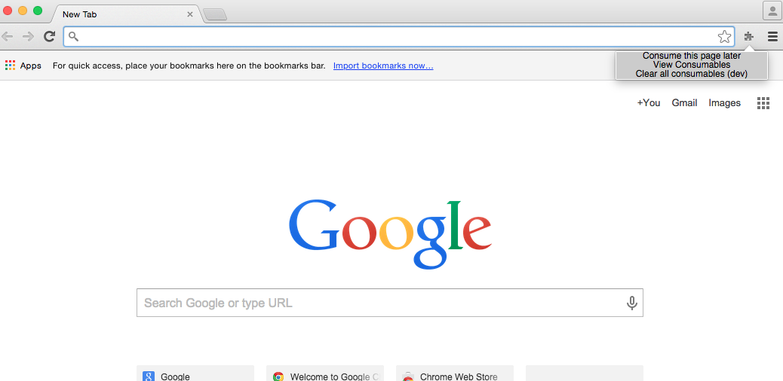

Slide 5
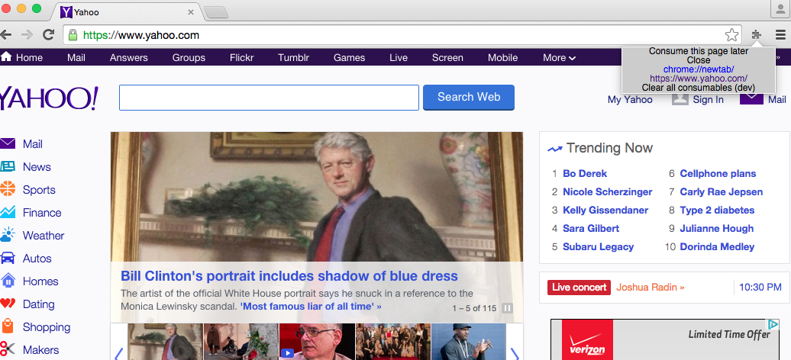

Slide 6
